Slide 1
SIMPLE STYLE
Adstore.tistory.com

Slide 2
SIMPLE STYLE
Adstore.tistory.com

Slide 3
SIMPLE STYLE
1. INTRODUCTION
2. STYLE?
3. SUGGESTION
4. DESIGN MOCKUPS
5. SUMMARY
Adstore.tistory.com

Slide 4
SIMPLE STYLE
Adstore.tistory.com

Slide 5
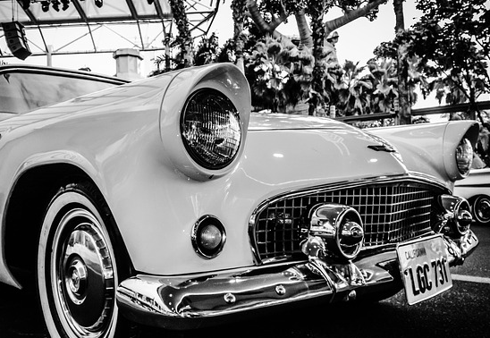
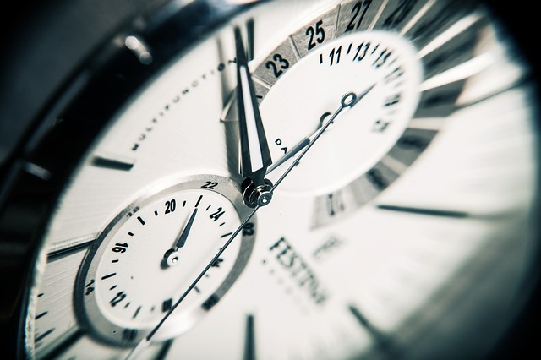
HOW ABOUT STYLE?
1
REVEAL YOUR LAYOUT
INDEX
HERE
Style
Cool

Slide 6
HOW ABOUT STYLE?
1
REVEAL YOUR LAYOUT
INDEX
HERE
It has become appallingly obvious that
our technology has exceeded our humanity.
- Albert Einstein

