Slide 1
LOBBY BOY
ADSTORE FREE PPT TEMPLATE

Slide 2
LOBBY BOY
INDEX
·
DESIGN
·
ART
·
CONCEPT
·
SUMMARY
·

Slide 3
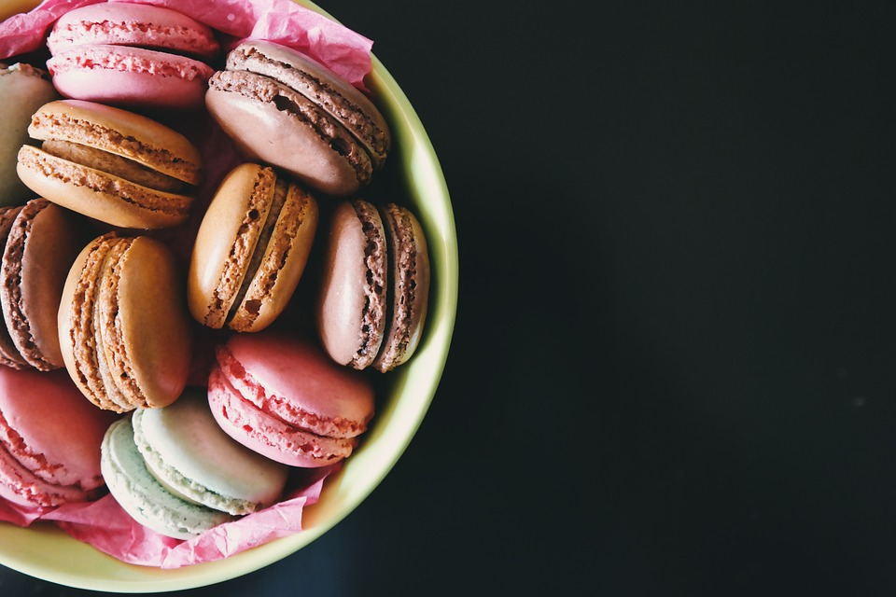
M.GUSTAVE
M.GUSTAVE
Rudeness is merely an expression of fear.
People fear they won't get what they want.
The most dreadful and unattractive person
only needs to be loved,
and they will open up like a flower.

Slide 4
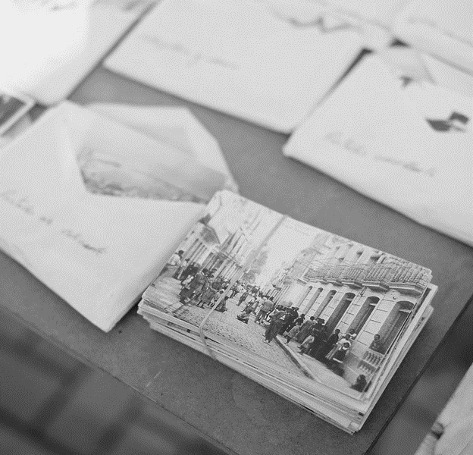
LOBBY BOY
ADSTORE PPT TEMPLATE
I must say, I find that girl utterly delightful.
Flat as a board, enormous birthmark
the shape of Mexico over half her face,
sweating for hours on end
in that sweltering kitchen, while Mendl,
genius though he is,
looms over her like a hulking gorilla.
Yet without question,
without fail, always and invariably,
she's exceedingly lovely.

