Slide 1
ADSTORE
HELLO
WORLD!
FREE TEMPLATE

Slide 2
HELLO
WORLD!
INDEX
-
01. GAME
02. RETRO
03.THEME
04. TEMP
05. CONTINUE
06. DESIGN
-

Slide 3
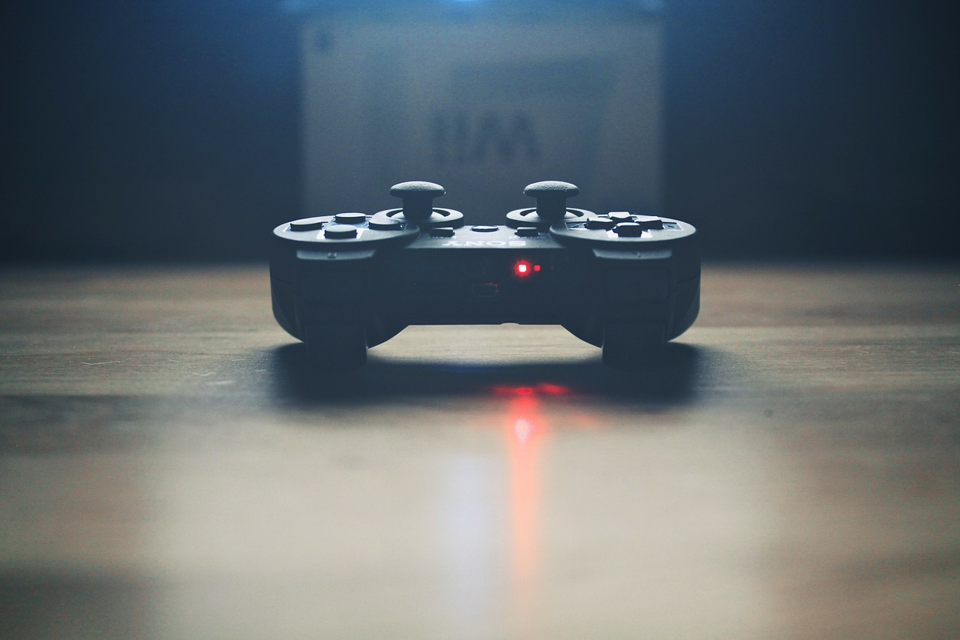
HELLO WORLD!
8BIT VIDEO GAME CHALLENGER!!!
VIDEO GAME
A video game is an electronic game that involves human interaction with a user interface to generate visual feedback on a video device.

Slide 4
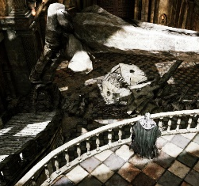
HELLO WORLD!
VIDEO GAME IN REAL LIFE
| GRAPHIC | SOUND | VISUALS | STORY|

