Slide 1
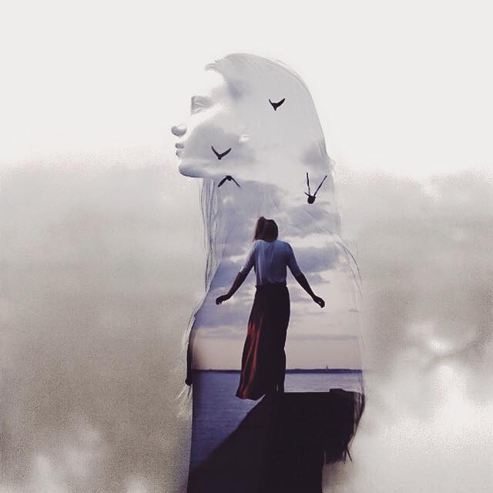
MODERN
GALLERY
ADSTORE FREE PPT TEMPLATE

Slide 2
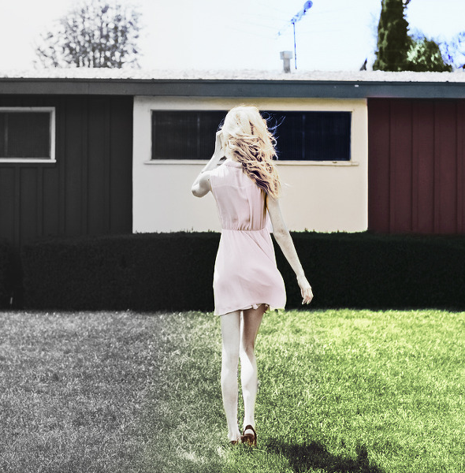
Color Me : About Me
Photoshop Coloring Concept Work
If they ever do my life story, whoever plays me needs lots of hair color and high heels | Original image by imageback.com | PT Designed by L@rgo Adstorepost.com | Facebook.com/adstorepost | Thank you
Modern Gallery

Slide 3
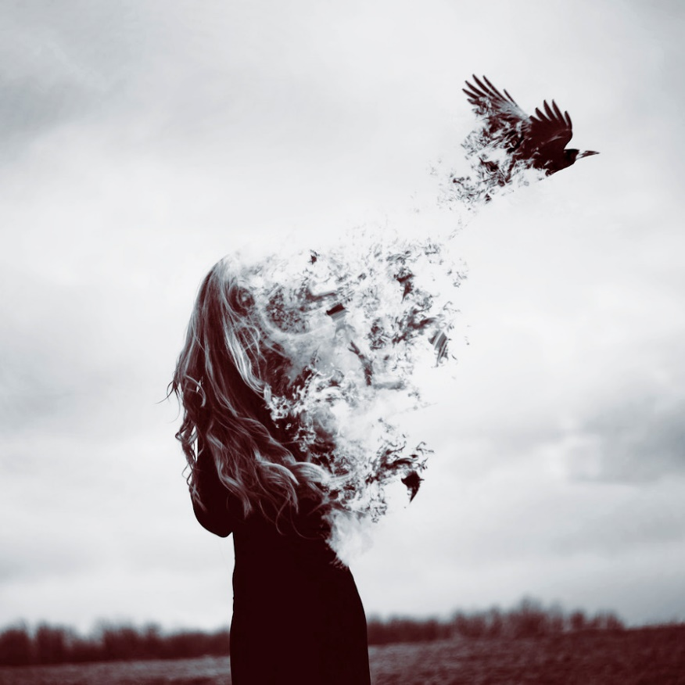
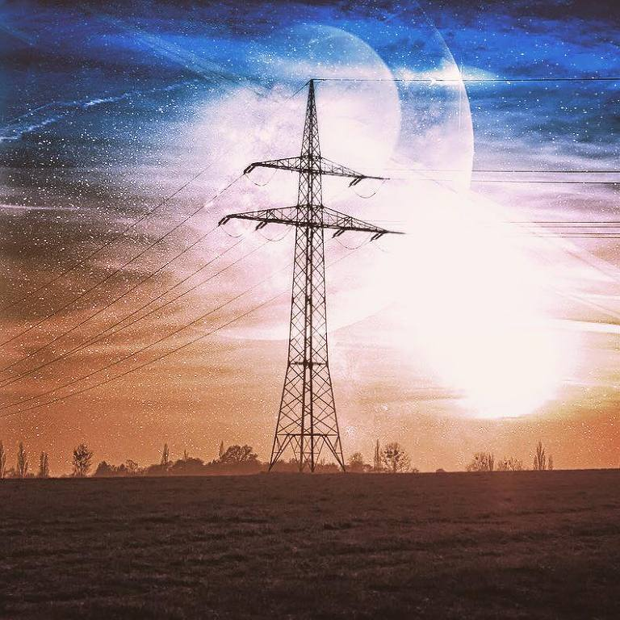
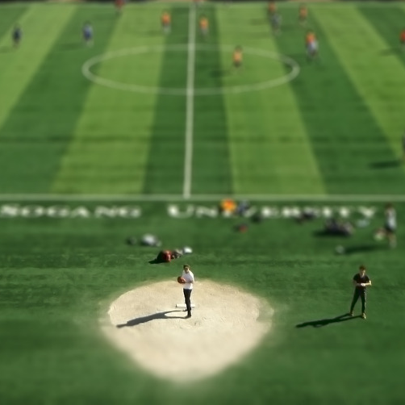
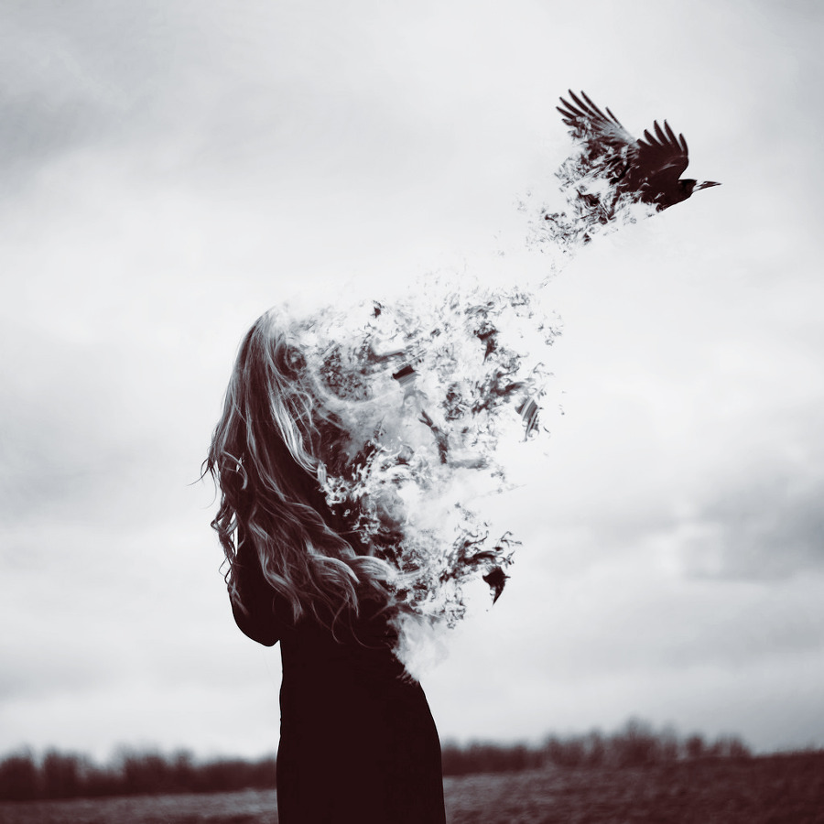
Dispersion
Modern Gallery
To The Moon
Mini Baseball
“In character, in manner, in style, in all things,
the supreme excellence is simplicity.”

Slide 4
Hello World
Modern Gallery
Dispersion
Girl
The best and most beautiful things in the world cannot be seen or even touched - they must be felt with the heart

Slide 5
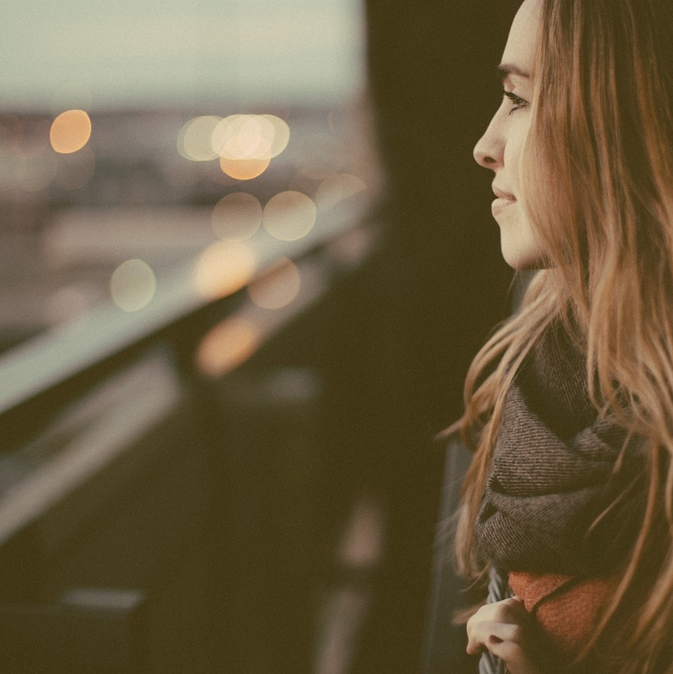
Urban Lights
Modern Gallery
Music can bring about different vibes on the field, off the field, urban life, going to church, leaving church. Everything the world may bring, there's a song for it to put you in the right frame of mind.

