Slide 1
DESIGN YOUR VISION
ADSTORE FREE PPT TEMPLATE

Slide 2
DESIGN
DESIGN YOUR VISION
01.
02.
03.
0.4
ART
CONCEPT
SUMMARY

Slide 3
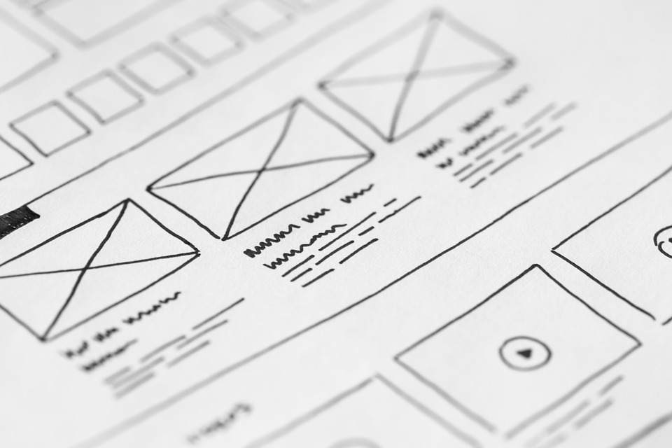
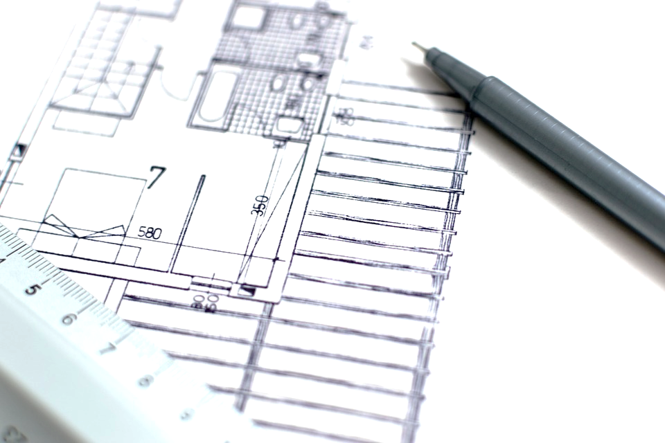
What if we rewrite the stars.
ADSTORE FREE PPT TEMPLATE
< Musical Scene #1. >
-
What if we rewrite the stars?
Say you were made to be mine
Nothing could keep us apart
You'd be the one I was meant to find
It's up to you, and it's up to me
No one can say what we get to be
So why don't we rewrite the stars?
Maybe the world could be ours
Comment
“ You think it's easy
You think I don't want to run to you
But there are mountains
And there are doors that we can't walk through
I know you're wondering why
Because we're able to be
Just you and me
Within these walls
But when we go outside
You're going to wake up and see that it was hopeless after all ”

Slide 4
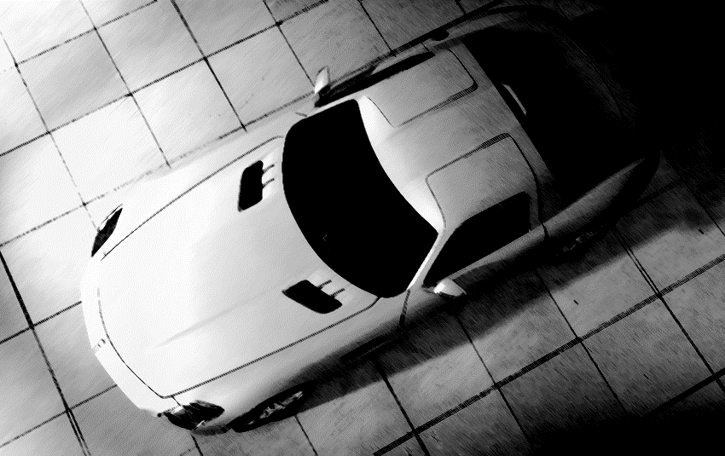
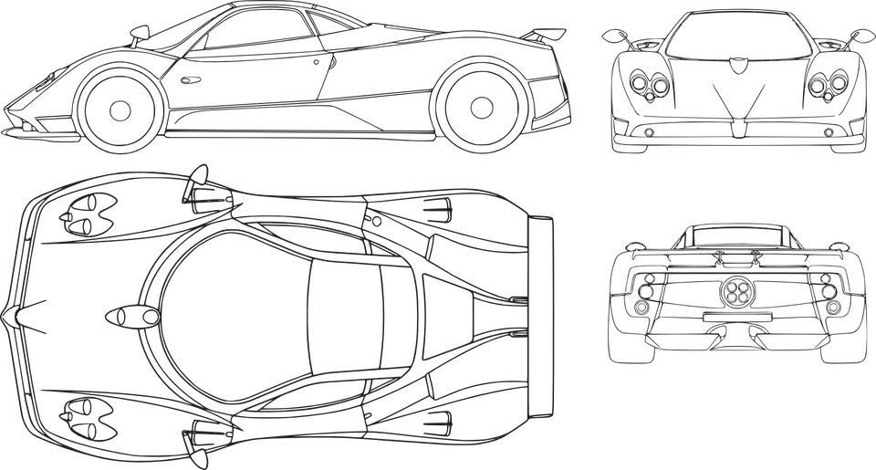
What if we rewrite the stars.
ADSTORE FREE PPT TEMPLATE
Concept Design

